Slide 1
Known issues

Slide 2
Units in CEF (#17)
Any issue in accepting cm, and potentially scm, in distributionUnit and variableUnit in CEF.DN (only for Length-related distribution types or WidthCarapace)
distributionType | Age, WidthCarapace, LengthCarapace, LengthMantle, LengthMaximumShell, LengthPreAnal, LengthPreCaudal, LengthStandard, LengthTotal | The kind of distribution provided, e.g., use Age for an age distribution, the appropriate length measurement type (LengthCarapace, LengthMantle, LengthMaximumShell, LengthPreAnal, LengthPreCaudal, LengthStandard and LengthTotal) for a length distribution and WidthCarapace for a width distribution Type of length or width measurement type should follow the specification in the data call | Accepted codes in this field: Age, WidthCarapace, LengthCarapace, LengthMantle, LengthMaximumShell, LengthPreAnal, LengthPreCaudal, LengthStandard, LengthTotal
distributionUnit | Nwr, y, mm | The unit of the distributionType. If distributionType = Age, then use Nwr or y. Use 'mm' for the Length-related distribution types or WidthCarapace. | Accepted codes in this field: Nwr, y, mm If distributionType = Age --> distributionUnit = y or Nwr if distributionType != Age --> distributionUnit = mm distributionUnit should be the same within vesselFlagCountry, year, workingGroup, stock, speciesCode, catchCategory, domainBiology and distributionType
variableType | WeightLive, Number, WidthCarapace, LengthCarapace., LengthMantle, LengthMaximumShell, LengthPreAnal, LengthPreCaudal, LengthStandard, LengthTotal | This specifies whether mean live weight (WeightLive), length (LengthCarapace, LengthMantle, LengthMaximumShell, LengthPreAnal, LengthPreCaudal, LengthStandard, or LengthTotal), width (WidthCarapace)or count (Number)s reported within a distribution. | Accepted codes in this field: WeightLive, Number, WidthCarapace, LengthCarapace., LengthMantle, LengthMaximumShell, LengthPreAnal, LengthPreCaudal, LengthStandard and LengthTotal variableType in (WidthCarapace, LengthCarapace, LengthMantle, LengthMaximumShell, LengthPreAnal, LengthPreCaudal, LengthStandard, or LengthTotal) is only possible when distributionType= Age
variableUnit | g, kg, mm, N, NE3 | The unit of the variableType. If variableType = Number, then variableUnit must be N or NE3 If variableType = WeightLive, then variableUnit must be g or kg If variableType is WidthCarapace, LengthCarapace, LengthMantle, LengthMaximumShell, LengthPreAnal, LengthPreCaudal, LengthStandard, or LengthTotal, then variableUnit must be mm. | Accepted codes in this field: g, kg, mm, N, NE3 If variableType = WeightLive -->variableUnit in (g,kg). If variableType = Number --> variableUnit in (N,NE3). If variableType in (WidthCarapace, LengthCarapace., LengthMantle, LengthMaximumShell, LengthPreAnal, LengthPreCaudal, LengthStandard, LengthTotal) --> variableUnit = mm

Slide 3
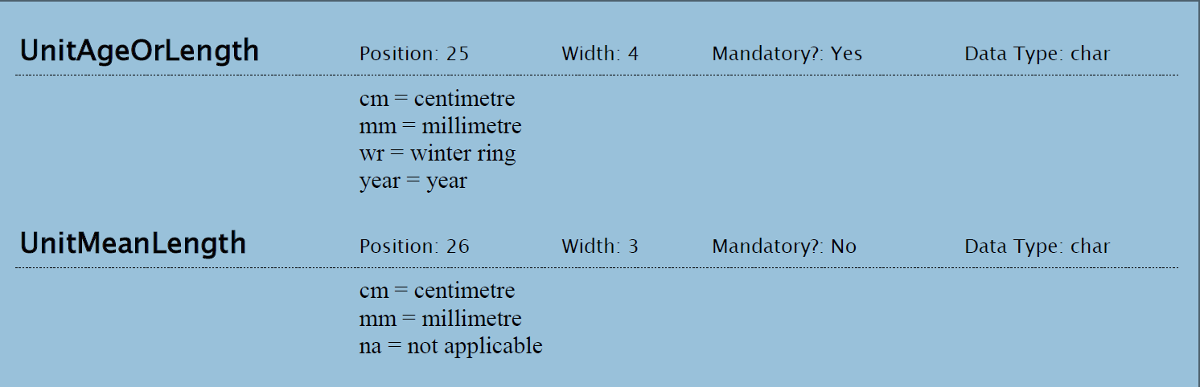
Units in CEF, Units InterCatch

Slide 4
Units in CEF, discussion
This is considered a low-priority issue

Slide 5
Units in SCF
OK to include in SCF.DC?
OK to include in SCF.DAR?
OK to include in SCF.DAS, if we go for the detailed solution?

Slide 6
Counts, Mandatory - problem
Counts are mandatory, since we think it is a valuable information for estimates. It is also used when selecting data for imputations.
It is a problem, when
  Reporting Official values as WGEstimate
  Translating InterCatch -9
  Translating SI records with discard and BMS estimates without any SD records (no counts at all)

Slide 7
Counts, Mandatory - official values
It is not possible to uploade official values as an WGEstimate for Dis, DisBMS and BMS, since you need to provide a count
domainCatchDis | This is the discard raising domain. It provides information about the level at which the estimate was made. Further, it serves as a link between landings and discards that enables the stock coordinator to calculate a ratio to be used for filling unsampled strata if needed. Naming convention: season_area/FMU_fleet_additional, e.g. 2025_27.4_GNS. domainCatchDis is mandatory when reporting a WGEstimate for Dis or DisBMS. If reporting census data as a WGEstimate, then domainCatchDis should still be filled to enable the stock coordinator to calculate a ratio to be used for filling unsampled strata if needed. If a domainCatchDis is provided, at least one row containing a WGEstimate for Lan must exist with the same domainCatchDis. If no landings are recorded for a given domainCatchDis, a landing of 0 must be reported with the corresponding domainCatchDis. | When CatchCategory = DisBMS or Dis and originType = WGEstimate --> DomainCatchDis = Mandatory. If a domainCatchDis exist, at least one row with a WGEstimate for CatchCategory = Lan should exist with the same domainCatchDis. If originType = Official --> DomainCatchDis should be NULL
domainCatchBMS | This is the BMS raising domain. It provides information about the level at which the estimate was made. Further, it serves as a link between landings and BMS, which enables the stock coordinator to calculate a ratio to be used for filling unsampled strata if needed. Naming convention: season_area/FMU_fleet_additional, e.g. 2025_27.4_GNS. domainCatchBMS is mandatory when reporting a WGEstimate for BMS or DisBMS. If reporting census data as a WGEstimate, then domainCatchBMS should still be filled to enable the stock coordinator to calculate a ratio to be used for filling unsampled strata if needed. If a domainCatchBMS is provided, at least one row containing a WGEstimate for Lan must exist with the same domainCatchBMS. If no landings are recorded for a given domainCatchBMS, a landing of 0 must be reported with the corresponding domainCatchBMS. | When CatchCategory = BMS or DisBMS and originType = WGEstimate --> DomainCatchBMS = Mandatory. If a domainCatchBMS exist, at least one row with a WGEstimate for CatchCategory = Lan should exist with the same domainCatchBMS. If originType = Official --> DomainCatchBMS should be NULL
PSU | The primary sampling unit (PSU) type. If samples from sampling schemes with different primary sampling units are used for the estimation, e.g., samples from an at-sea program with fishing trip as the PSU and an on-shore program with landing event as the PSU, then put in the different PSU in a semicolon seperated list. | Accepted codes in this field: Location, LandingEvent, FishingTrip, FishingOperation, TemporalEvent, Vessel, OnshoreEvent If PSU is specified the you should give a numPSU. If domainCatchDis | domainCatchBMS is not null and catchCategory != 'LAN', then this is mandatory
numPSUs | Count of PSUs that provided actual samples used in the estimate, so not the total number of PSUs the estimate may represent. If no actual samples were collected for a PSU (e.g., samples were borrowed to obtain the estimate), a value of 0 should be reported. | If domainCatchDis | domainCatchBMS is not null and catchCategory != 'LAN', then numPSUs is mandatory

Slide 8
Counts, Mandatory – solution?
We could make it optional
  This will solve the problem, but we end up with not getting any counts, like in InterCatch
We could have a fiels a la dataSource from RDBES.CL (This would require a code for IC import for a optimal solution), then counts are only mandatory for some
  See example
Any other suggetion?
DataBasis //vocab.ices.dk/?ref=1767 | Allowed codes are: “Official” and "Estimated" “Official”: Official data, which can be 1) census data (e.g. control regulation data as logbooks, sales notes, declarative forms eventually combined) or 2) official sampling data. “Estimated”: Data coming from scientific estimates based on scientific sampling or scientific reevaluation and not officially registered and/or reported. Do not provide overlapping data.
DataSource //vocab.ices.dk/?ref=1768 | Data Source of scientific weight. When DataBasisOfScientificWeight is “Official”, Allowed codes are: "CombOD", "Logb", "OthDF", "SalN". When When DataBasisOfScientificWeight is “Estimated”, Allowed codes are: "SampDS", "SampDC", "Exprt", "OthDF", "CombOD".

Slide 9
Official values as an WGEstimate
We have originType (Official | WGEstimate) to allow for the reporting of official figures, since this have been requested in the past
Only WGEstimate’s will be processed and go into the assessment

Slide 10
counts of PSUs and trip level counts (#25)
What to count, when the estimation domain is on a finer level than the PSU or trip and upper-than-trip PSUs end up in more domain?
E.g., say a trip visits several areas. Stock coordinator might be better informed with No of hauls than with current trips and PSUs (No of vessels under H1).
My preliminary opinion: there is not single good way to inform all Stock Coordinators of sampling levels via a single format like the CEF. Rather, the plan should be that stock coordinators define the information that is meaningful (together with the data submitters) and ask for it to be included in a stock specific table/report routinely issued alongside the CEF estimates. TAF automation will make this easy to achieve (just an additional output). I am tempted to suggest the sampling levels are removed from the CEF format in the next update so that emphasis can be put on defining those simpler reports/overviews and including them in the TAF format immediately for the next round of stocks.

Slide 11
Counts, what to count
Count Landing Event (LE) or Fishing Operation (FO)
  These table have counts per time, space and fleet. In LE it is only dominant
Count Sample (SA)
  Actually time, space and fleet
‘-‘ (minus after the record type) means mandatory but not in the estimation hierarchy.
‘()’ (the record type in brackets) means optional and not in the estimation hierarchy.
H1 | H2 | H3 | H4 | H5 | H6 | H7 | H8 | H9 | H10 | H11 | H12 | H13
DE | DE | DE | DE | DE | DE | DE | DE | DE | DE | DE | DE | DE
SD- | SD- | SD- | SD- | SD- | SD- | SD- | SD- | SD- | SD- | SD- | SD- | SD-
VS | FT | TE | OS | OS | OS | OS | TE | LO | VS | LO | LO | FO
FT | FO | VS | FT | LE | FT | SS | VS | TE | TE | TE | TE | (FT)
FO | SS | FT | LE | (FT) | (LE) | LE- | LE | SS | FT | FT | LE | SS
SS | SA | FO | SS | SS | FO | SA | (FT) | SA | FO | LE- | (FT) | SA
SA |  | SS | SA | SA | SS |  | SS | LE- | SS | SS | SS
 |  | SA |  |  | SA |  | SA |  | SA | SA | SA

Slide 12
Counts
Delete PSU and numTrips in CEF.CN
Keep numTrips, but include SU a count for FO / LE / Mixed (FO, LE)
Keep PSU, but include SU a count for FO / LE / Mixed (FO, LE)

Slide 13
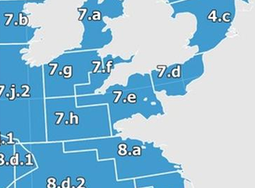
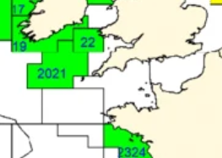
FMU (AreaNonFAO)
We need the Fisheries Management Units (FMU’s) in the format, but how?
Present solution:
stock | areaType | areaValue | fisheriesManagementUnit
nep.fu.2021 | ICESArea | 27.7.f | FU.20-21
nep.fu.2021 | ICESArea | 27.7.g | FU.20-21
nep.fu.2021 | ICESArea | 27.7.h | FU.20-21
nep.fu.2021 | ICESArea | 27.7.j | FU.20-21

Slide 14
FMU (AreaNonFAO)
- Highly relevant for pil.27.8c9a
Both areaType and FMU in CN and EN
Not that nice, since we need to declare all the associated FAO areas for a FMU in both CN and EN
Effort becomes stock specific by introducing FMU’s in EN
We have working groups where stock specific FMU’s are overlapping, so the present solution won’t work for these stocks
FMU as an areaType (like IC today)
Effort becomes stock specific
CEF.EN tables will potentially hold a lot of overlapping data within an area, but the SC will only see effort from the areas relevant (combination of FMU’s and ICES areas)
FMU in CN, but not in EN
EN is not stock specific
We would need ICESArea to link between CN and EN, so still a need for declaring all the associated FAO areas for a FMU in CN

Slide 15
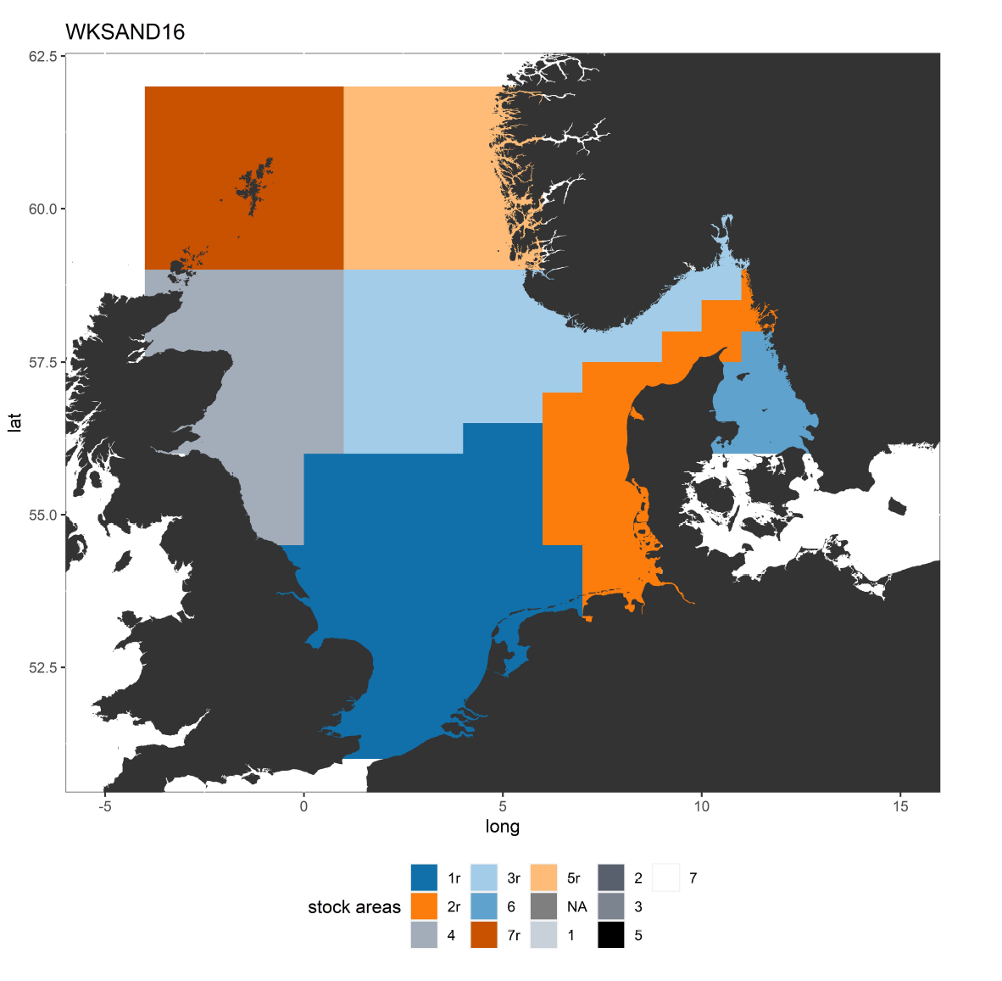
Overlapping FMU within a WG
(This may be a very hypothetically, since we don’t provide effort to HAWG)

Slide 16
What data do you get as a SC
CEF.CN, CEF.DN and CEF.SN – stock specific
CEF.EN – areas covered by the stock (combination of FMU’s and ICES areas)

Slide 17
Do anyone use effort in the model?
Stock | Selected stock | Use effort in the model?
Her.27.20-24 | N | N
San.27. | N | Y
Spr.27.3a4 | N | N
Sol.27.7fg | Y | N
Bll.27 | Y | N
Pil. | Y | N

Slide 18
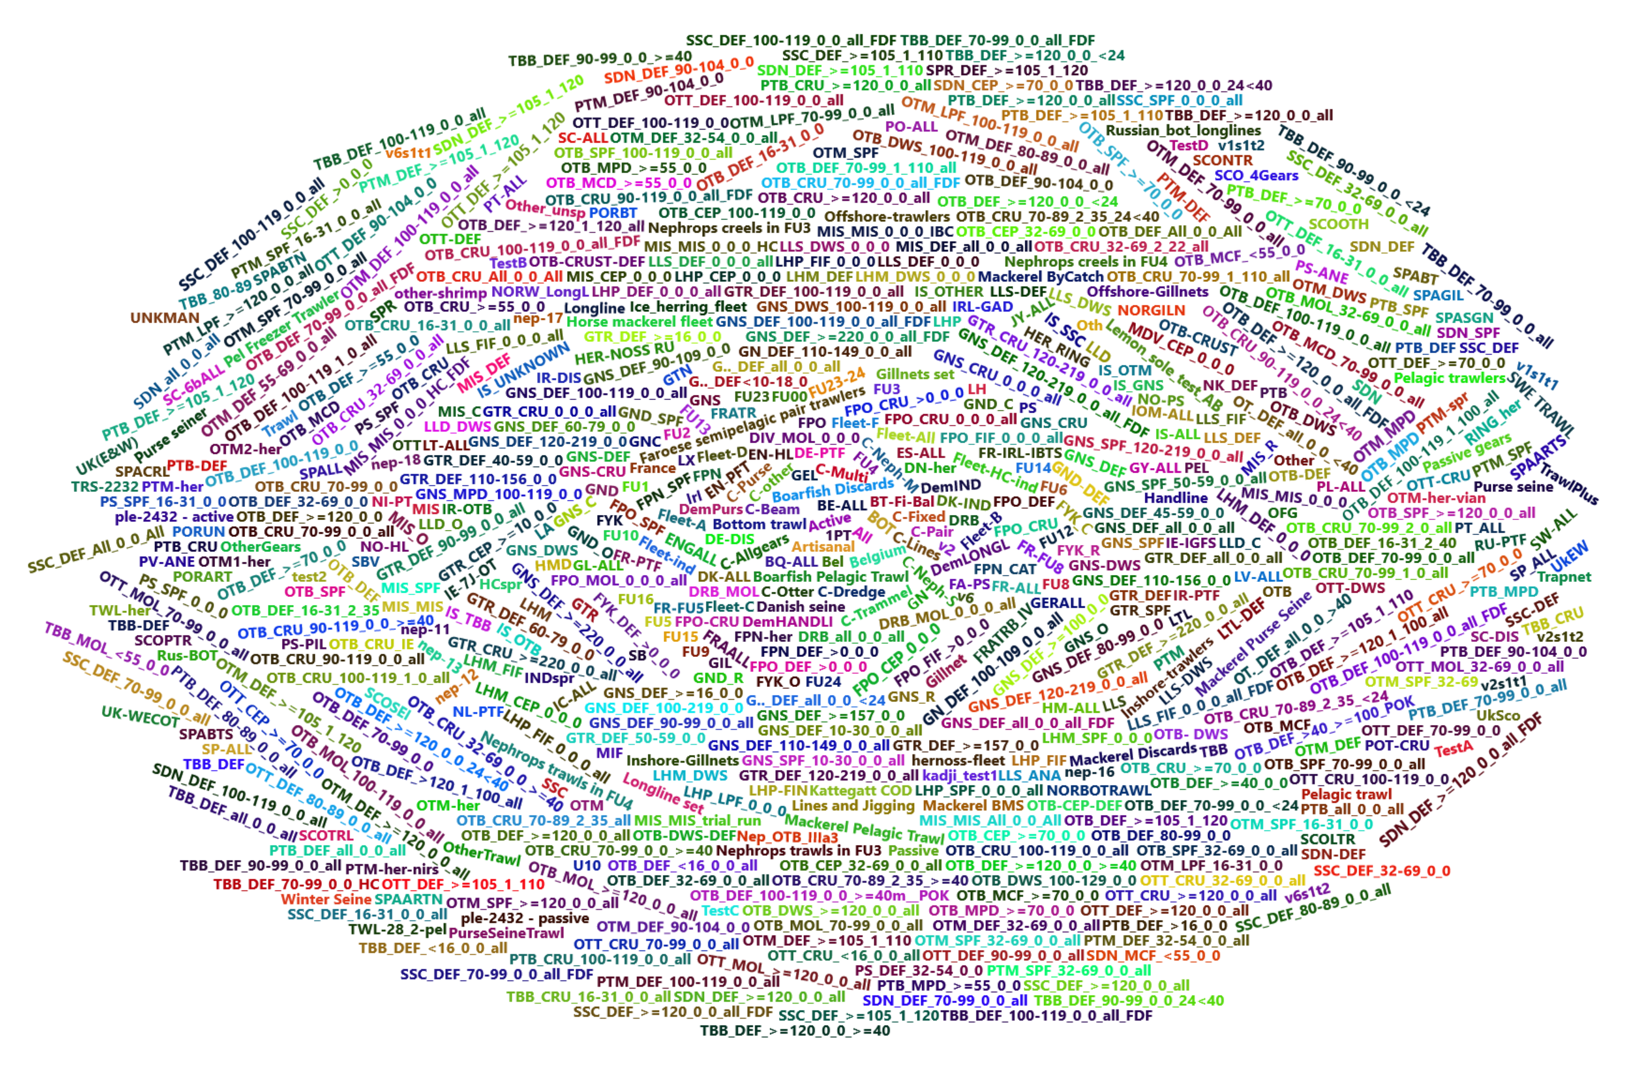
Fleets
Chairs needed
A lot of poorly documented IC fleets, fleets that looks like métiers, but aren't, and uncertainty on what different institutes are including in specific fleets
So, a new fleet code list is needed, ….
A meeting will be organized in 2026 with representatives from the 9 stocks, ICES, WGRDBES-stockCoord, WGCATCH and MIXFISH, so we can find a way to make this transparent for the future
(The future solution can lead to changes in the format)

Slide 19
Upload of CEF
Check against the code list
(e.g. BE: CNPSU = fishingtrip; UK: DNPSU = Fishingtrip

